Slide 1

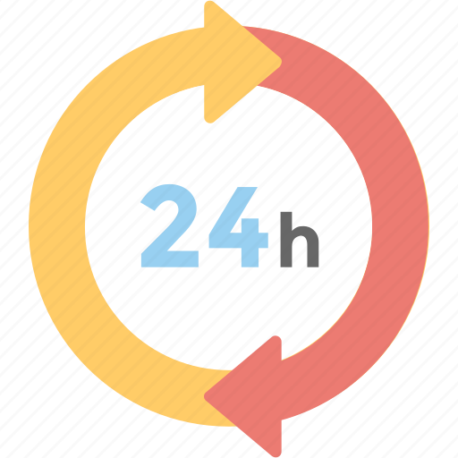
24-HOUR FORECAST
2-11-2022 @ 1200 UTC
Department of Meteorology and Climate Science,
KNUST

Slide 2
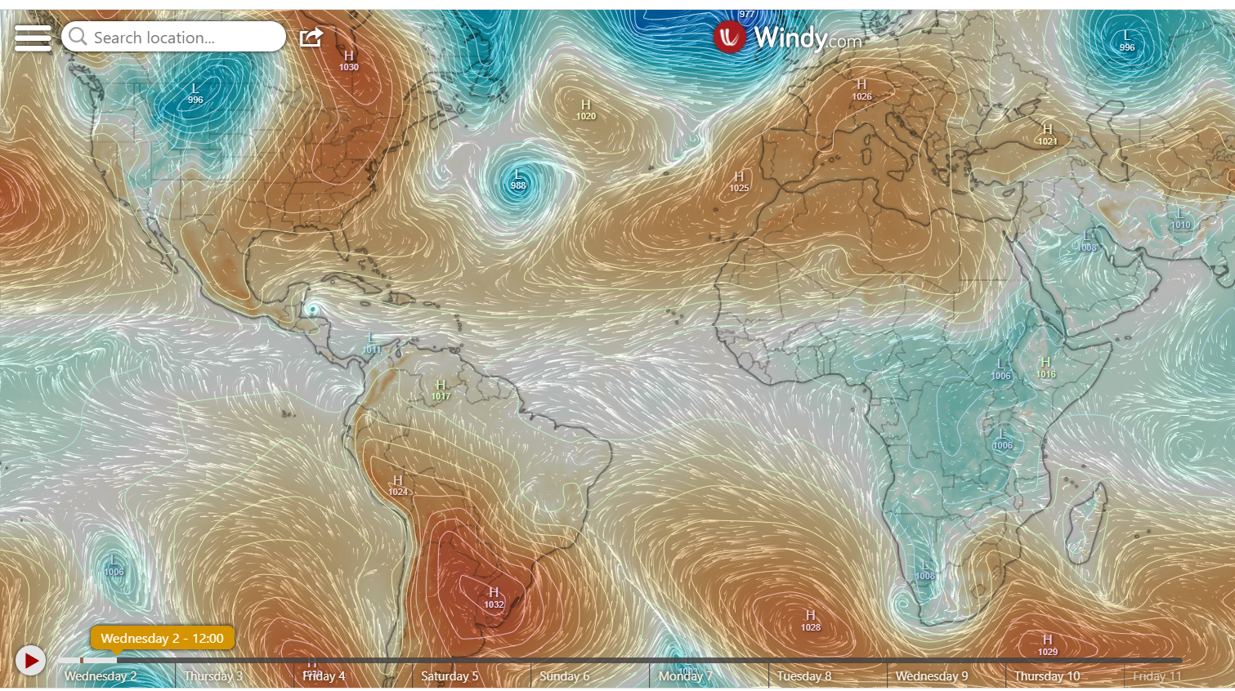
PRESSURE SYSTEMS @ 1200 UTC
1020hPa
1032hPa

Slide 3
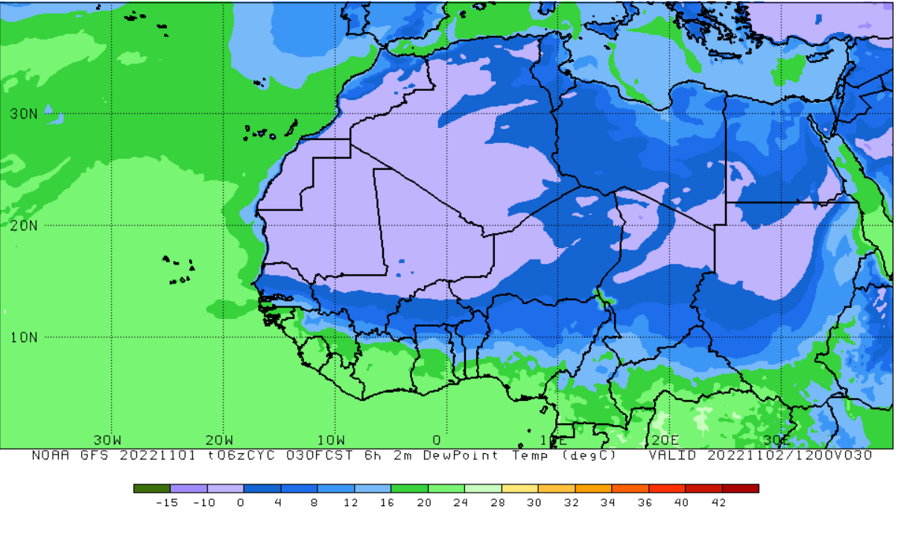
ITD POSITION @ 1200 UTC
8ºN

Slide 4
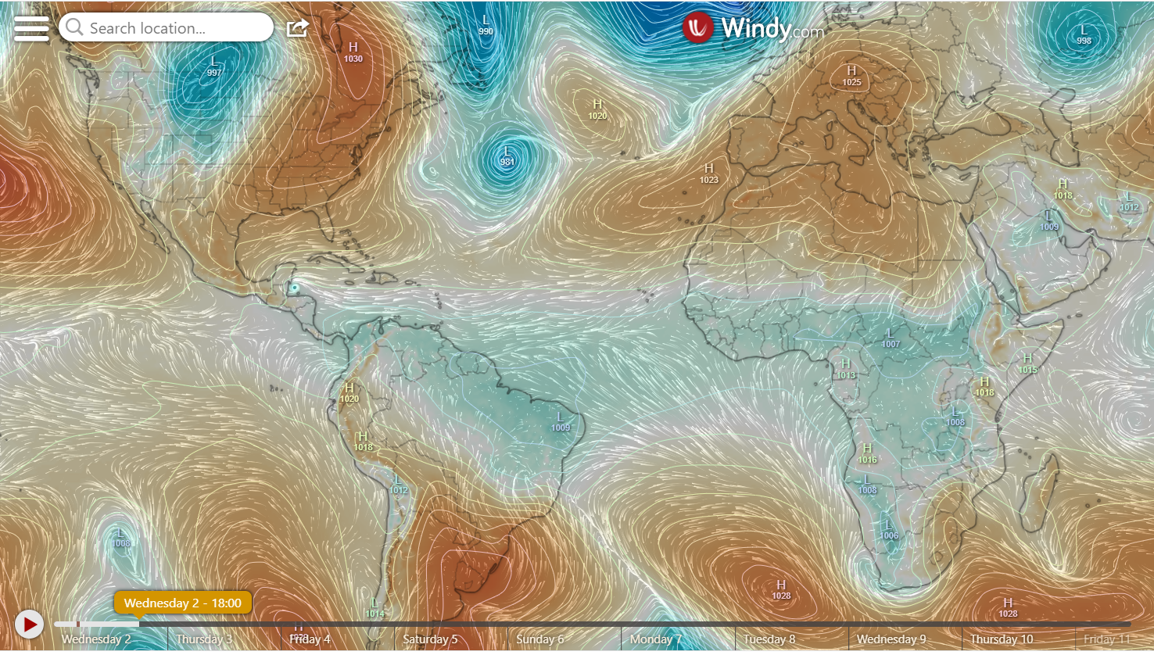
PRESSURE SYSTEMS @ 1800 UTC
1020hPa
1028hPa

Slide 5
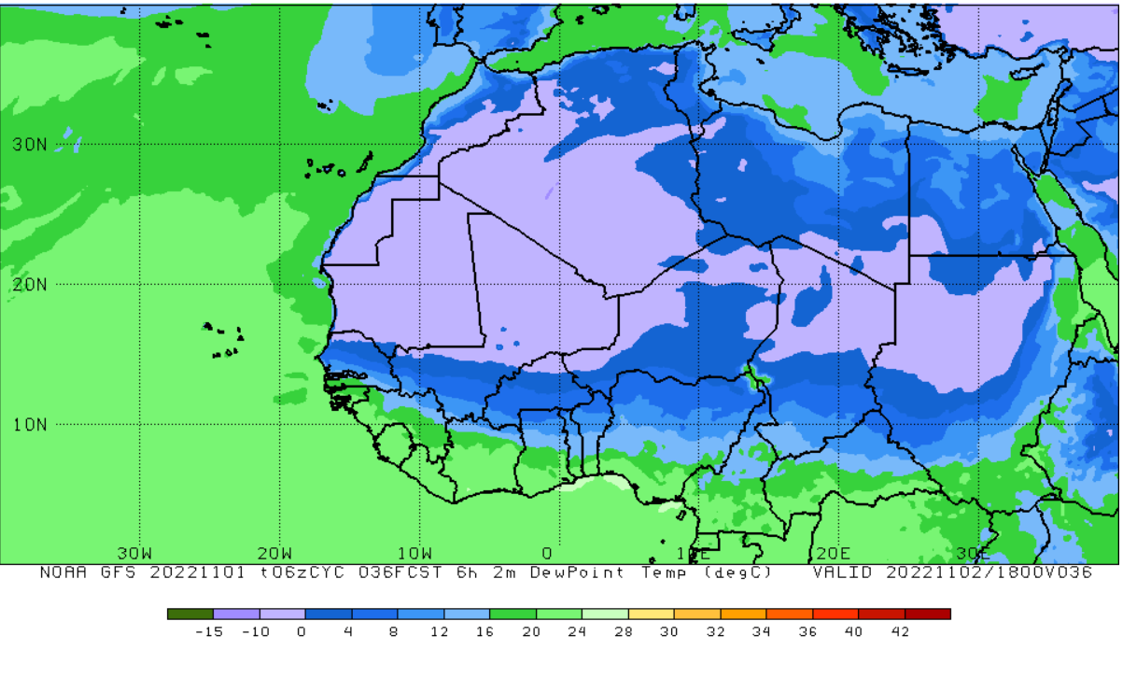
ITD POSITION @ 1800 UTC
7ºN

Slide 6
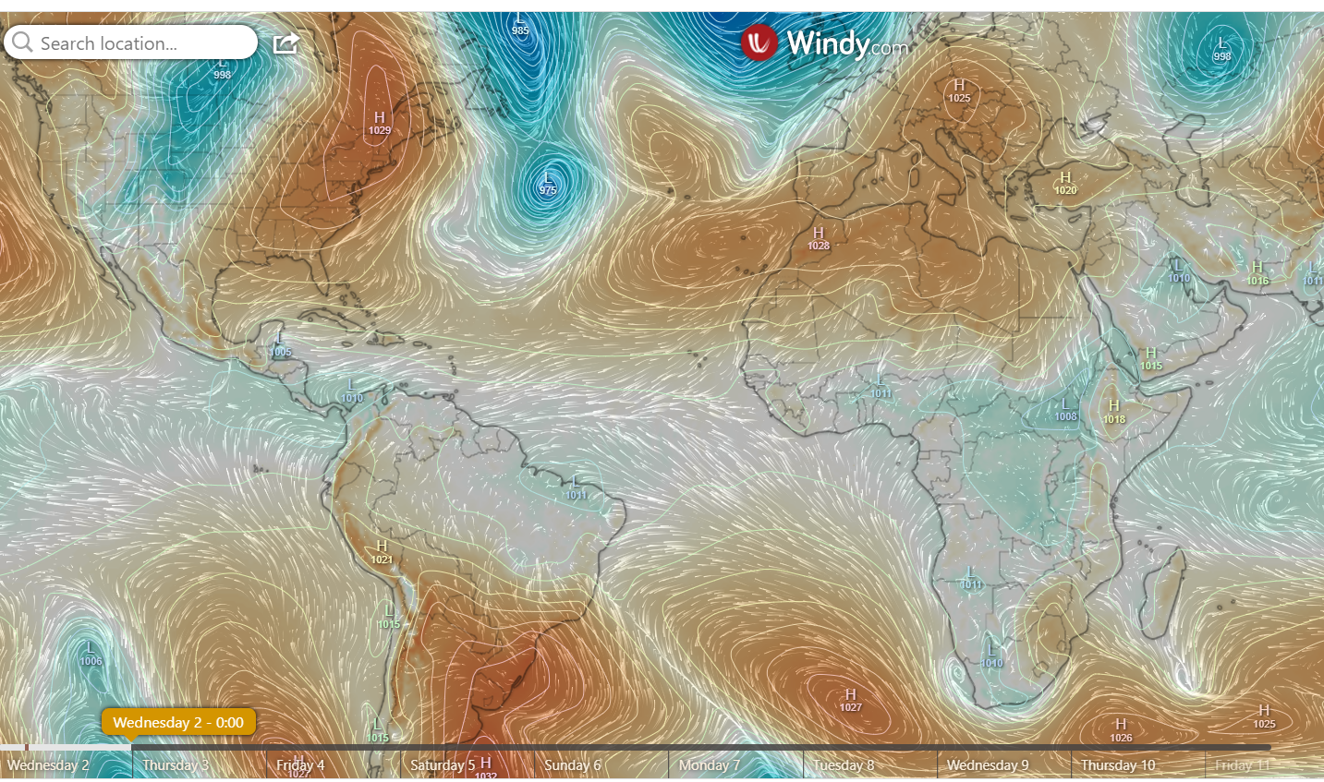
PRESSURE SYSTEMS @ 0000 UTC
1020hPa
1027hPa

Slide 7
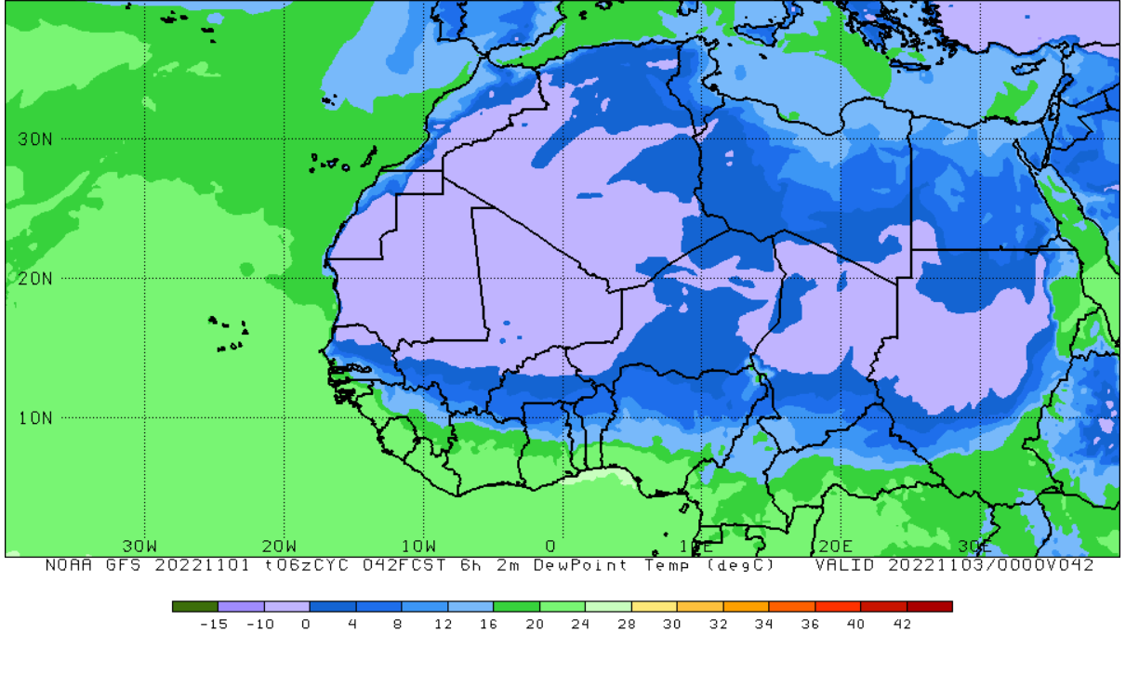
ITD POSITION @ 0000 UTC
7ºN

Slide 8
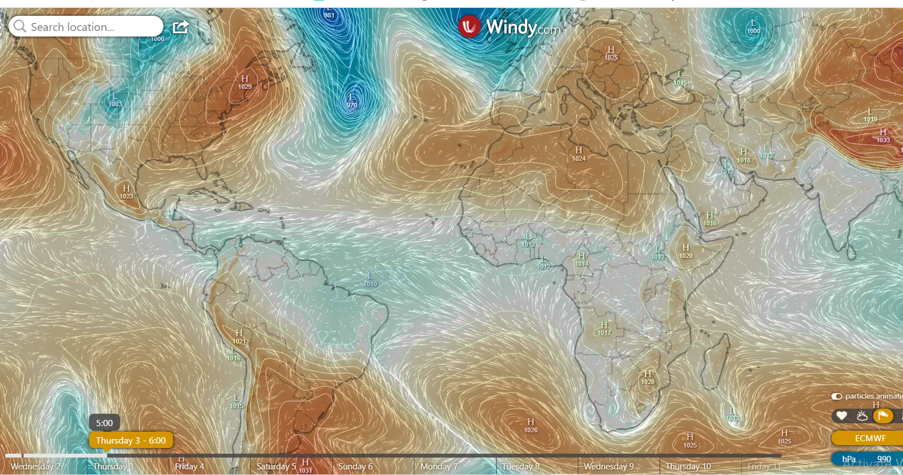
PRESSURE SYSTEMS @ 0600 UTC
1021hPa
1026hPa

Slide 9
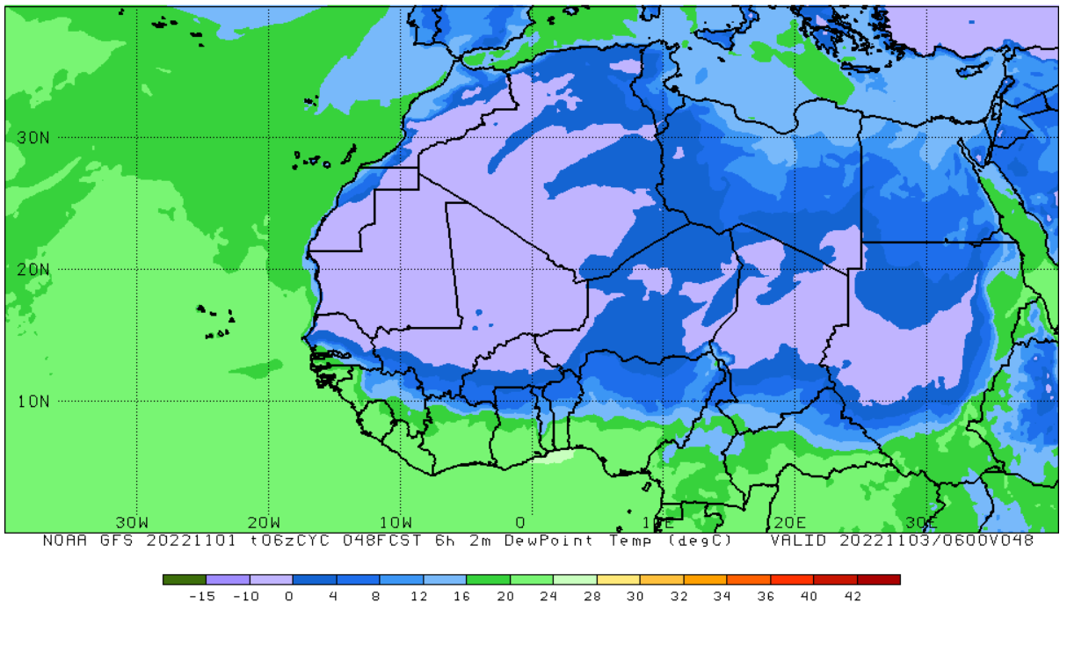
ITD POSITION @ 0600 UTC
7.1ºN

Slide 10
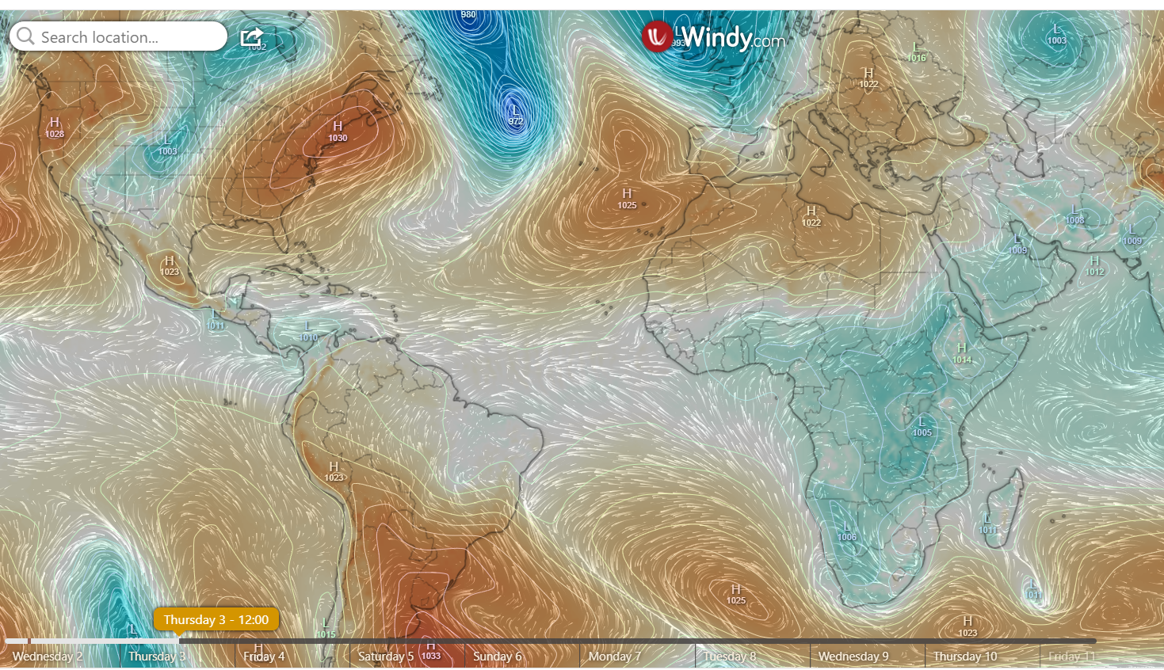
PRESSURE SYSTEMS @ 1200 UTC
1025hPa
1025hPa

Slide 11
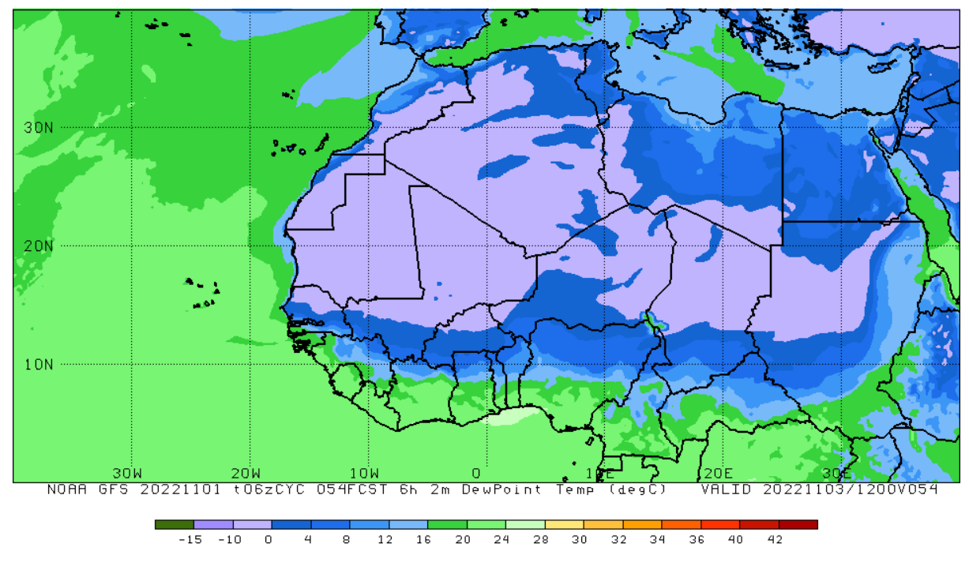
ITD POSITION @ 1200 UTC
7ºN

Slide 12
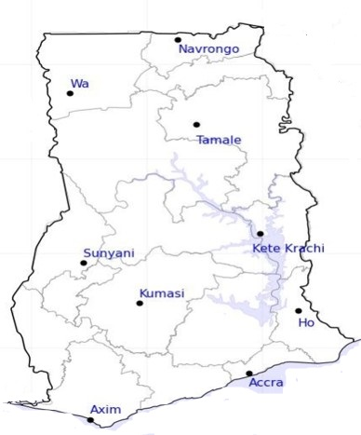

38
24-HOUR FORECAST
2-11-2022 @ 1200 UTC
38
RH AT DAY
[%]
40
55
67
72
71
69
80
83

Slide 13
49
24-HOUR FORECAST
2-11-2022 @ 1200 UTC
53
47
RH AT NIGHT
[%]
67
75
87
92
90
87
87

Slide 14
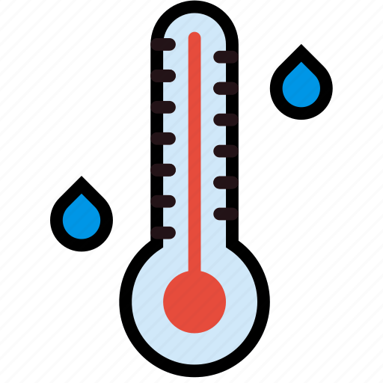
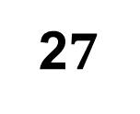
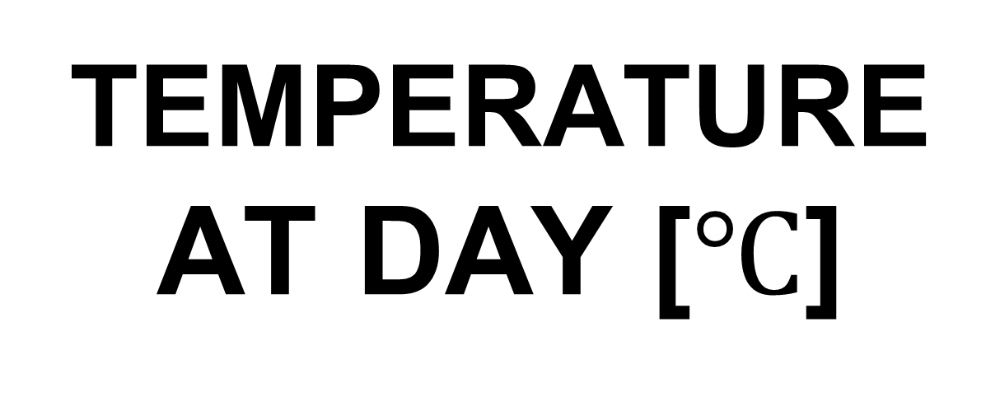
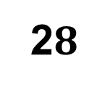
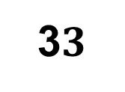
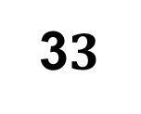
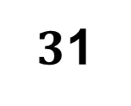
35
24-HOUR FORECAST
2-11-2022 @ 1200 UTC
3$3$
35
TEMPERATURE AT DAY [$℃$]
3$3$
32
31
$3$1
31
2$8$
2$7$

Slide 15
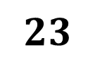

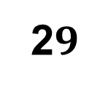
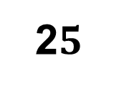
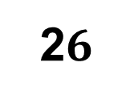
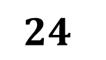
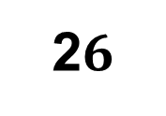
25
24-HOUR FORECAST
2-11-2022 @ 1200 UTC
2$6$
TEMPERATURE AT NIGHT [$℃$]
28
$$24$$
2$9$
2$5$
$$23$$
25
27
2$6$

Slide 16
GENERAL OUTLOOK
24-HOUR FORECAST
2-11-2022 @ 1200 UTC
PROBABILITY OF RAINS
0%

Slide 17


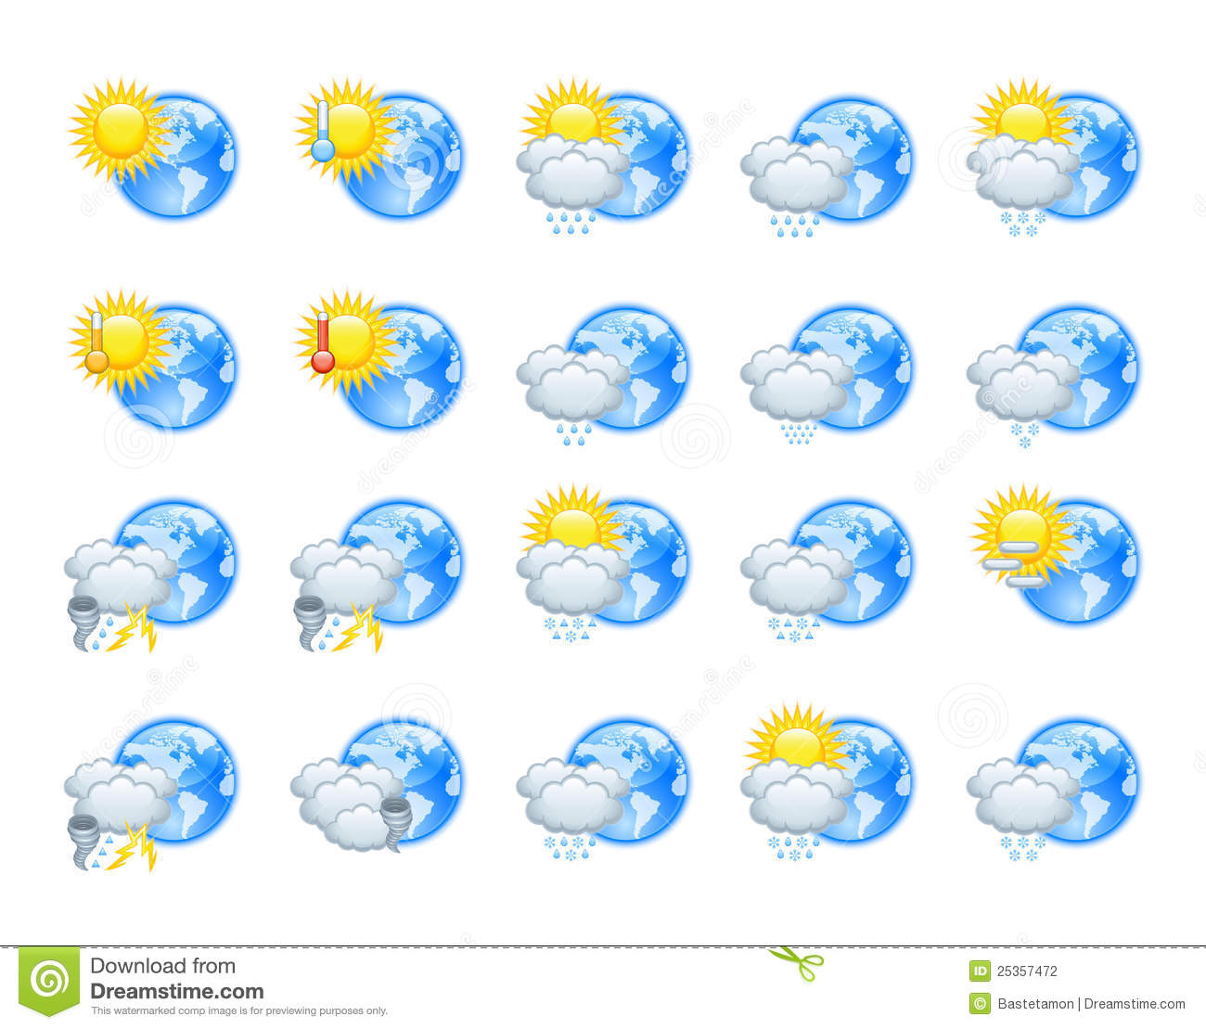





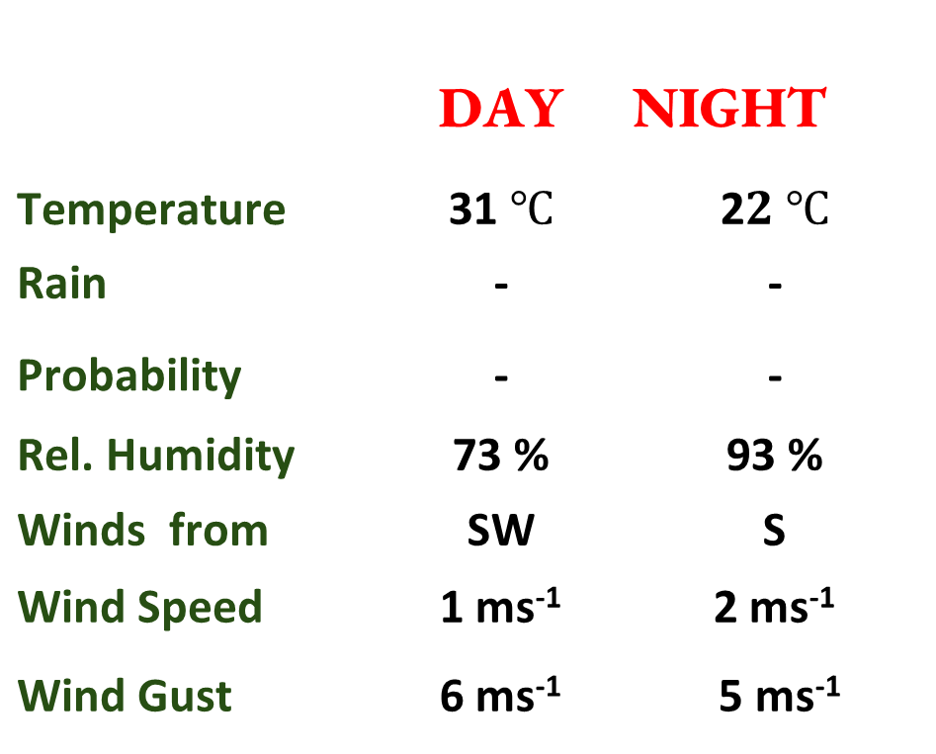
Department of
Meteorology and Climate Science KNUST
24-HOUR FORECAST
2-11-2022 @ 1200 UTC
Rain
Wind
Dust
Forecast Summary (KUMASI)
 | DAY | NIGHT
Temperature | 31 $℃$ | 2$2 ℃$
Rain | - | -
Probability | - | -
Rel. Humidity | 73 % | 93 %
Winds from | SW | S
Wind Speed | 1 ms⁻¹ | 2 ms⁻¹
Wind Gust | 6 ms⁻¹ | 5 ms⁻¹
Low risk
Be aware
Be Prepared
Take Action
SUNSET: 05:56 PM SUNRISE: 05:54 AM

Slide 18


